Slide 1
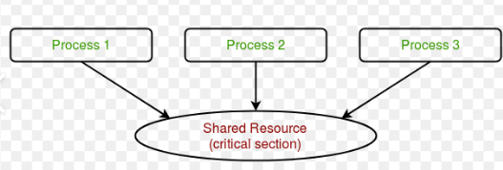
Unit 3 Process Synchronization (PS)
By:
Amandeep Kaur

Slide 2
Why Process Synchronization (PS)?
The main reason is shared resources like code, data, scanner, printer, variable etc.

Slide 3
Types of Process(2)
S.NO. | CON-CURRENT PROCESS (P) | CO-OPERATIVE PROCESS (T)
1 | It is also known as Independent Process. | It is also known as Dependent Process.
2 | Serial Mode (eg. ATM M/C) | Parallel Mode (eg. Printer in CAFÉ)
3 | Execution of one process does not effect the execution of another process. | Execution of one process does effect the execution of another process.
4 | Nothing common. | Shared resources concept.(like variable,code etc.)
5 | All concepts of Process as completed in UNIT 1. | All concepts of Thread as completed in UNIT 1.
6 | For eg. Transactions from SBI to HDFC bank (due to diff. server),Music | For eg. Transactions from HDFC to HDFC bank (due to diff. server),Music

Slide 4
Example
int Shared=5;
P1
P2
int X=Shared;
X++;
Sleep(1);
Shared=X;
int Y=Shared;
Y--;
Sleep(1);
Shared=Y;

Slide 5
Race Condition
In this eg. 4 and 6 having race with each other that’s why in this situation, it is called Race Condition. (because in this case 4 and 6 doing race).
Therefore, this process is not synchronized. So, there is a need of synchronization to handle this problem.
To resolve this problem there is so many ways like semaphores, Peterson’s solution etc.

Slide 6
Remember Points:
Uni-Processor ( Mostly in Laptop, Mobile phones)
Time Sharing (Multiple process run at a same time)
Due to Uni-Processor, Only 1 Process will execute but not in Multi-Processor case.
Process can be paused via Sleep() but CPU can not be paused because it is not under user but OS can easily do this.

Slide 7
It is the part of the program where share resources are accessed by various processes(Co-operative Processes) which share something and have something common like code, variable, memory, buffer etc.
So, it is a place where shared variables or resources are placed. There are 5 sections in each program:
Non-Critical Section (NCS) //Nothing common
Entry Section //Lock the resources
Critical Section (CS) //common resources or shared resources
Exit Section //Unlock the resources
Remainder Section //give signal to the next process
Critical Section

Slide 8
It’s a way to achieve Process Synchronization (PS) and this is a Mechanism or (3 Conditions/Rules):
Mutual Exclusion (1 by 1 process exe. Via Lock and Unlock entry)
Progress (No J-Factor)
Bounded Wait (Upper time limit)
How to achieve Synchronization?

Slide 9
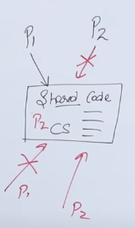
Mutual Exclusion
(eg. Lock & Unlock Entry System of our Home)

Slide 10
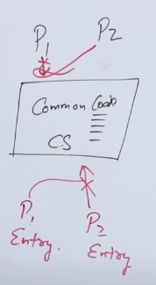
Progress
(eg. No J- Factor in society)

Slide 11
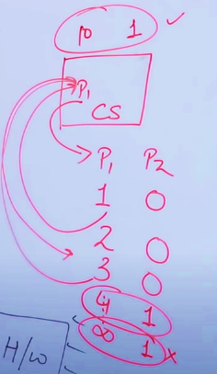
Bounded Wait
(Set Upper Time Limit i.e. Remove Starvation Problem via this)

Slide 12
CSP (Critical Section Problem)
CSP: It ensuring only one process accesses shared resource at a time.
Methods for CSP:
Lock Entry
Unlock Entry
CSP especially resolved by Semaphore.

Slide 13
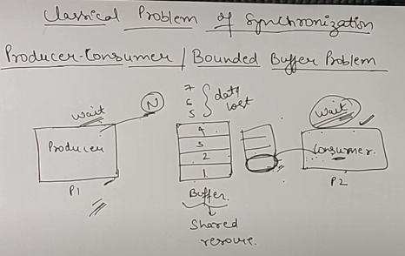
Producer-Consumer Problem or Bounded Buffer Problem

Slide 14
In this eg. There is 1 CS, 2 Users and 4 Conditions:
For eg. : UMS //CS
User 1: Programmer
User 2: Student
4 conditions: Here R means Reader and W means Writer.
R-R
R-W
W-R
W-W
No issue for R-R case but for other conditions its problem or user are unable to access the website.
Reader-Writer Problem

Slide 15
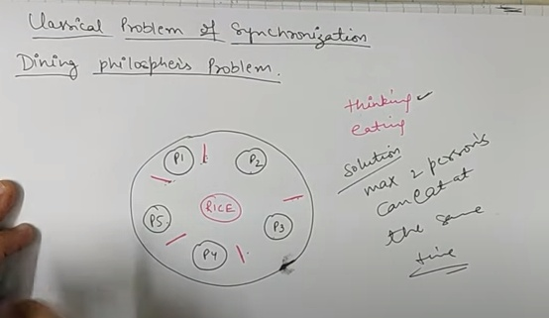
Dining Philospher’s Problem

Slide 16
Semaphore (S) is an integer variable (int S;) that solves the CSP. After initialization (int S=1;), it can only be accessed by 2 atomic operations:-
1. Wait // //decrement the value of semaphore. (S--)
2. Signal //increment the value of semaphore. (S++)
Note: By default the value of Semaphore is always 1. i.e. S=1
For eg.
1. wait(S) //decrement S
{
While(S<=0);
S=S-1;
}
2. Signal(S) //increment S
{
S=S+1;
}
Semaphores

Slide 17
Types of Semaphores (2)
Binary Semaphore: is used when there is only one instance of a resource. Hence the semaphore can have two value: 1 for free and 0 for busy. (MUTEX) i.e. 2 process solution here.
Counting Semaphore is used when there are multiple instances of the same resource. For example, there are 5 Printers. This means there are 5 instances of the resource Printer. Now 5 process can simultaneously print. So, the initial value of the semaphore variable should be 5 i.e., equal to the number of instances available. i.e. n-process solutions here.

Slide 18
Adv.
1.They donot allow more than 1 process to enter in CS.
2. No waste of resource due to busy waiting.
3. Allow flexible management of resources.
Disadv.
Priority inversion
Adv. & Disadv. of Semaphores

Slide 19
When there are more than 2 Processes then applied N-process classical solution.
int Lock=0;
While(Lock==1);
Lock=1
CS //Critical Section
Lock=0
Note:
It works in User Mode.
Provide multi-process solution.
Does not guarantee Mutual Exclusion.
N-Process Solution

Slide 20
2-Process Solution
Lock variable:
Lock1=False
Lock2=False
P2
P1
Lock1=True
While(Lock2);
CS
Lock1=False
Lock2=True
While(Lock1);
CS
Lock2=False
Note: There is no progress but ME and Bounded wait is possible.

Slide 21
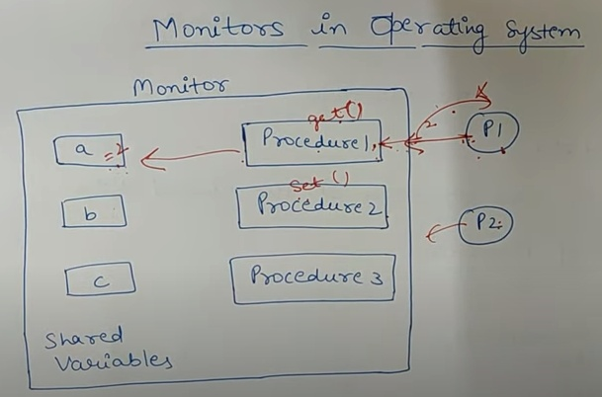
Monitors
A monitor is a module that contains:
Shared data
Procedures that operates on the shared data.

Slide 22
Like in JAVA (monitor is a class)
monitor
{
condition variables;
Variables;
Procedure 1
{
……………
……………
}
Procedure 2
……………
……………
}
Syntax of Monitor

Slide 23
Hierarchy of processes
Parent –Child Process
It has a tree like structure.
Fork()
Pid : Process ID
Ppid: Parent Process ID

Slide 24
H/W primitives for synchronization
H/W primitives are special atomic instructions for implementations of synchronization primitives. (TSL- Test and Set Lock, Semaphores, Lock/Unlock, entry/exit section, Mutex (standard variable) etc.

Slide 25
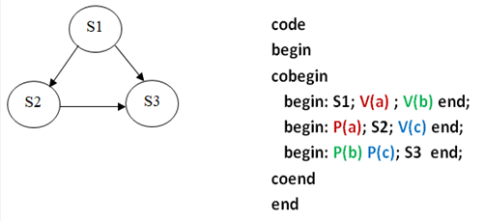
Precedence Graph is a directed acyclic graph which is used to show the execution level of several processes in operating system.
Precedence Graph

Slide 26
REFERENCES
OPERATING SYSTEM CONCEPTS by ABRAHAM SILBERSCHATZ, PETER B. GALVIN, GERG GAGNE, WILEY
DESIGN OF THE UNIX OPERATING SYSTEM by MAURICE J. BACH, Pearson Education India
REAL-TIME SYSTEMS by JANE W. S. LIU, Pearson Education India
https://www.gatevidyalay.com/operating-system/
Kalvium online reading resource

Slide 27
MCQ: What is the purpose of process synchronization in operating systems?
To improve CPU utilization
To coordinate access to shared resources
To reduce memory usage
To increase program speed

Slide 28
Ans. B
B) To coordinate access to shared resources

Slide 29
Which of the following is a type of process synchronization technique?
A) Context switching
B) Interrupt handling
C) Semaphores
D) Deadlock

Slide 30
Answer: C
C) Semaphores

Slide 31
Which of the following is a disadvantage of using semaphores for process synchronization?
A) It can cause deadlocks
B) It can cause starvation
C) It is not efficient in multi-user systems
D) It can cause priority inversion

Slide 32
Answer: D) It can cause priority inversion
Priority Inversion is a condition that occurs in a priority-based scheduling system. It is a situation where an activity of higher priority (H) has to wait while a work of lower priority (L) executes due to its ongoing work on the critical section

Slide 33
What is the purpose of monitors in process synchronization?
A) To provide mutual exclusion
B) To provide exclusive access to a resource
C) To provide a way to communicate between processes
D) To provide a way to interrupt a process

Slide 34
Answer: A
A) To provide mutual exclusion

Slide 35
Which of the following is a type of deadlock in process synchronization?
A) Starvation deadlock
B) Resource deadlock
C) Priority inversion deadlock
D) Mutual exclusion deadlock

Slide 36
Answer: B
B) Resource deadlock

Slide 37
What is the purpose of Peterson's algorithm in process synchronization?
A) To solve the problem of convoy effect
B) To solve the problem of priority inversion
C) To solve the problem of starvation deadlock
D) To solve the problem of mutual exclusion

Slide 38
Answer: D
D) To solve the problem of mutual exclusion

Slide 39
What is a semaphore in operating systems?
A) A variable that is used to coordinate access to shared resources
B) A type of interrupt handler
C) A type of CPU scheduling algorithm
D) A type of memory allocation technique

Slide 40
Answer: A
A) A variable that is used to coordinate access to shared resources

Slide 41
What is the value of a binary semaphore?
A) 0 and 1
B) 1 and 2
C) 0 and more than 1
D) 1 and more than 2

Slide 42
Answer: A
A) 0 and 1

Slide 43
What is the purpose of a semaphore in process synchronization?
A) To provide mutual exclusion
B) To provide exclusive access to a resource
C) To provide a way to communicate between processes
D) To prevent deadlocks

Slide 44
Answer: A
A) To provide mutual exclusion

Slide 45
What is a Precedence Graph in Operating Systems?
A) A graphical representation of the process scheduling algorithm
B) A graphical representation of the resource allocation
C) A graphical representation of the process dependencies
D) A graphical representation of the system's memory allocation

Slide 46
Answer: C
C) A graphical representation of the process dependencies

Slide 47
What is the purpose of a Precedence Graph in Operating Systems?
A) To determine the optimal process scheduling algorithm
B) To detect and prevent deadlocks in the system
C) To visualize the dependencies between processes and resources
D) To allocate system resources to processes

Slide 48
Answer: C
C) To visualize the dependencies between processes and resources

Slide 49
What is the problem that can occur when a producer produces data at a rate that is faster than the consumer can consume it in the Producer-Consumer Problem?
A) Starvation
B) Deadlock
C) Busy Waiting
D) Livelock

Slide 50
Answer: A
A) Starvation
In the Producer-Consumer Problem, a producer produces data and a consumer consumes the data. If the producer produces data at a rate that is faster than the consumer can consume it, the consumer may not be able to access the data, leading to starvation. This is because the producer continues to produce data, even if the consumer is not ready to consume it, and the consumer may be unable to access the data until the producer has finished producing it.

Slide 51
What is the problem that can occur in a Dining Philosophers Problem when all philosophers are holding their forks and waiting for one more fork to be released, in a system that uses a central algorithm to manage the forks?
A) Starvation
B) Deadlock
C) Livelock
D) Busy Waiting

Slide 52
Answer: C
C) Livelock
In the Dining Philosophers Problem, a central algorithm is used to manage the forks. If all philosophers are holding their forks and waiting for one more fork to be released, the system will enter a livelock state. This is because each philosopher is waiting for another philosopher to release a fork, but no philosopher can release a fork because they are all waiting for another philosopher to release a fork. This cycle continues indefinitely, causing the system to enter a livelock state.

Slide 53
What is the hardware primitive that allows a process to test whether a shared variable is zero or non-zero, and is commonly used to implement semaphores?
A) Flip-flop
B) Bit
C) Test-and-Set
D) Load-Link/Store-Conditional

Slide 54
Answer: C) Test-and-Set
In computer architecture, Test-and-Set (TS) is a hardware primitive that allows a process to test whether a shared variable is zero or non-zero, and if it's non-zero, sets it to zero. It is commonly used to implement semaphores, which are a fundamental concept in synchronization. TS is typically implemented using a combination of logical and arithmetic operations, and it provides a way to atomically test the value of a shared variable and modify it if necessary.

Slide 55

Thank you

